Slide 1
Generalized Belief Propagation
Jonathan Yedidia
Mitsubishi Electric Research Labs
work done with
Bill Freeman (MIT) &
Yair Weiss (Jerusalem)

Slide 2
Outline
Factor graphs and Belief Propagation
Region-based free energies
Bethe free energy and BP
Generalized BP

Slide 3
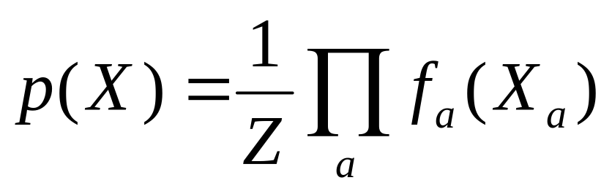
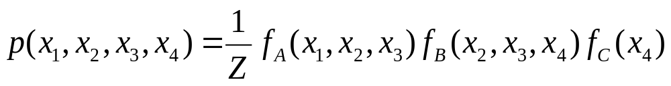
Factor Graphs
1
2
3
4
A
B
C

Slide 4
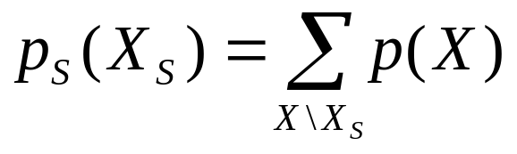
Computing Marginal Probabilities
Fundamental for
Decoding error-correcting codes
Inference in Bayesian networks
Computer vision
Statistical physics of magnets
Non-trivial because of the huge number of terms in the sum.

Slide 5
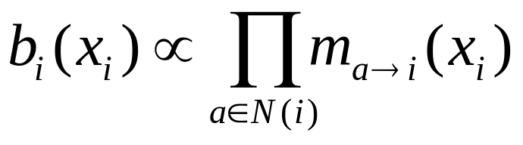
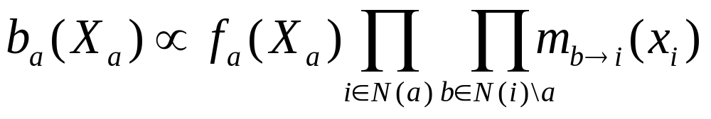
Standard Belief Propagation
i
“beliefs” “messages”
a
The “belief” is the BP approximation of the marginal probability.

Slide 6
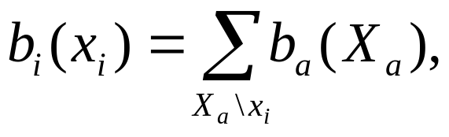
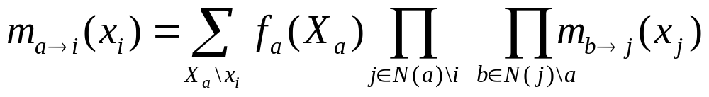

BP Message-update Rules
we get
Using
i
a
i
a
=

Slide 7
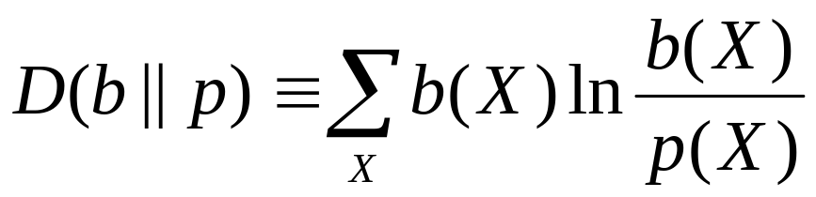
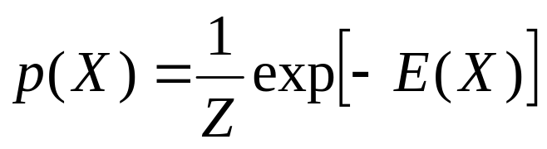
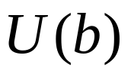
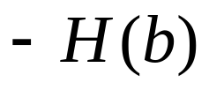
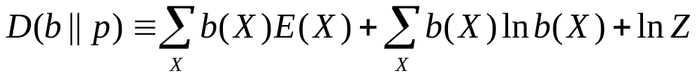


Variational (Gibbs) Free Energy
Kullback-Leibler Distance:
“Boltzmann’s Law” (definition of “energy”):
Gibbs Free Energy ; minimized when

Slide 8
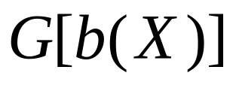
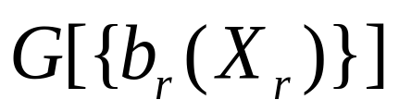
Region-based Approximations to the Gibbs Free Energy
(Kikuchi, 1951)
Exact:
Regions:
(intractable)

Slide 9
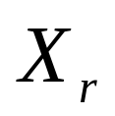
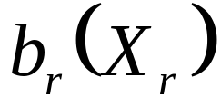
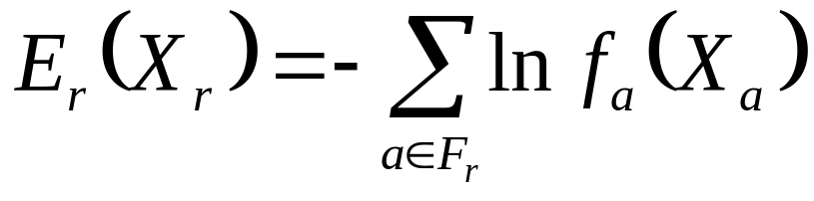
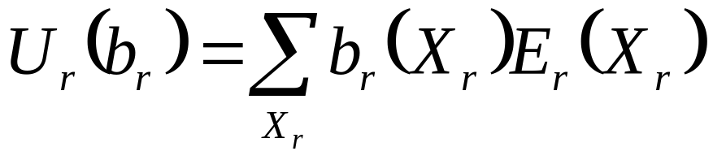
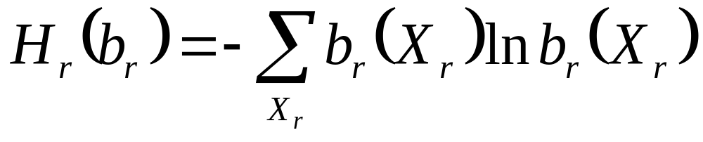
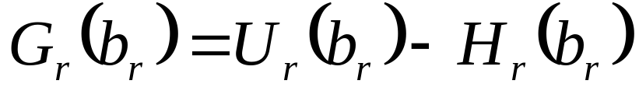
Region Definitions
Region states:
Region beliefs:
Region energy:
Region average energy:
Region entropy:
Region free energy:

Slide 10
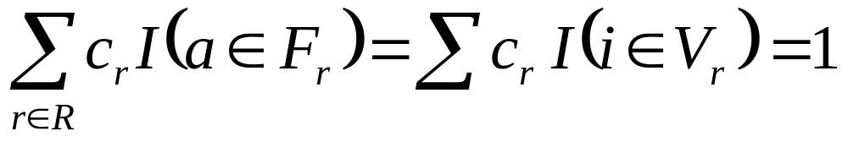
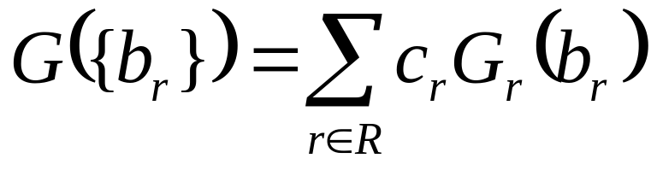
“Valid” Approximations
Introduce a set of regions R, and a counting number c_{r} for each region r in R, such that c_{r}=1 for the largest regions, and for every factor node a and variable node i,
Indicator functions
Count every node once!

Slide 11
Example of a Region Graph
A,C,1,2,4,5
B,D,2,3,5,6
C,E,4,5,7,8
D,F,5,6,8,9
2,5
C,4,5
D,5,6
5,8
[5] is a child of [2,5]
5

Slide 12


Bethe Method
(after Bethe, 1935)
Two sets of regions:
Large regions containing a single factor node a and all attached variable nodes.
Small regions containing a single variable node i.
1
2
3
A
B
4
C
5
D
6
E
F
7
8
9
A;1,2,4,5
B;2,3,5,6
C;4,5
D;5,6
E;4,5,7,8
F;5,6,8,9
1
2
3
4
5
6
7
8
9

Slide 13
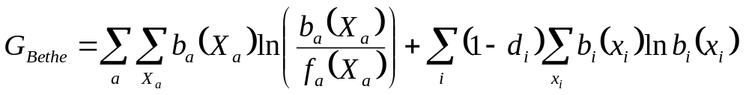
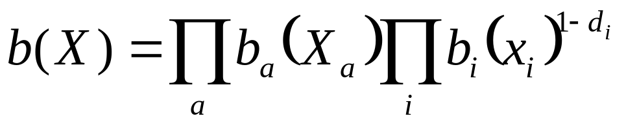
Bethe Approximation to Gibbs Free Energy
Equal to the exact Gibbs free energy when the factor graph is a tree because in that case,

Slide 14
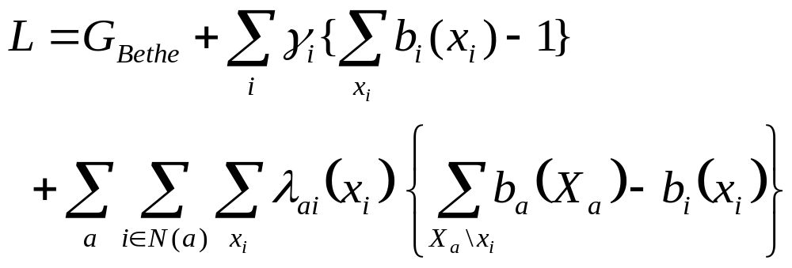
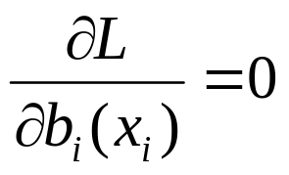
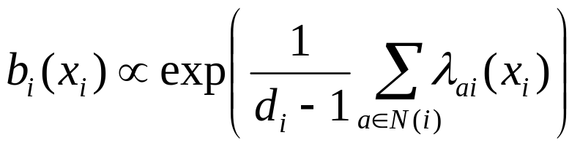
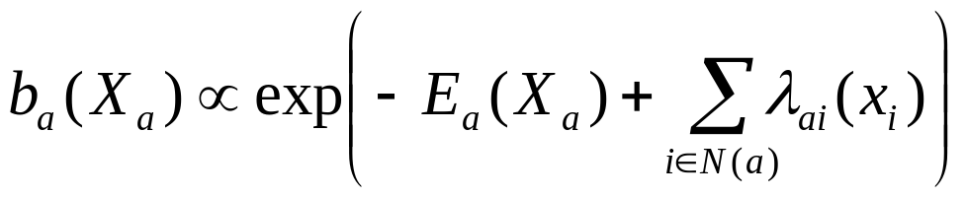
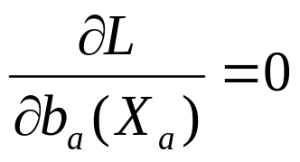
Minimizing the Bethe Free Energy

Slide 15
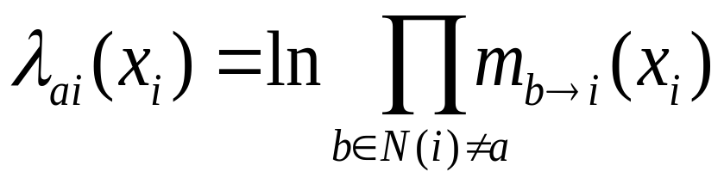
Bethe = BP
Identify
to obtain BP equations:
i

Slide 16
Generalized Belief Propagation
Belief in a region is the product of:
  Local information (factors in region)
  Messages from parent regions
  Messages into descendant regions from parents who are not descendants.
Message-update rules obtained by enforcing marginalization constraints.

Slide 17
Generalized Belief Propagation
1245
2356
4578
5689
25
45
56
58
1
2
3
5
4
5
6
7
8
9

Slide 18

Generalized Belief Propagation
1245
2356
4578
5689
25
45
56
58
1
2
3
5
4
5
6
7
8
9

Slide 19
Generalized Belief Propagation
1245
2356
4578
5689
25
45
56
58
1
2
3
5
4
5
6
7
8
9

Slide 20


Generalized Belief Propagation
1245
2356
4578
5689
25
45
56
58
1
2
3
5
4
5
6
7
8
9

Slide 21

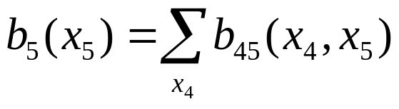
Generalized Belief Propagation
Use Marginalization Constraints to Derive Message-Update Rules
1
2
3
1
2
3
=
4
5
6
4
5
6
7
8
9
7
8
9

Slide 22
Generalized Belief Propagation
Use Marginalization Constraints to Derive Message-Update Rules
1
2
3
1
2
3
=
4
5
6
4
5
6
7
8
9
7
8
9

Slide 23
Generalized Belief Propagation
Use Marginalization Constraints to Derive Message-Update Rules
1
2
3
1
2
3
=
4
5
6
4
5
6
7
8
9
7
8
9

Slide 24
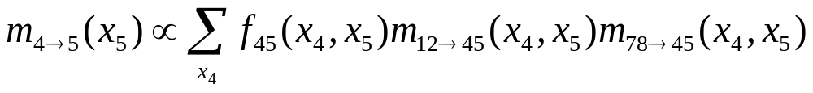
Generalized Belief Propagation
Use Marginalization Constraints to Derive Message-Update Rules
1
2
3
1
2
3
=
4
5
6
4
5
6
7
8
9
7
8
9

Slide 25
10x10 Ising Spin Glass
Random fields
Random interactions

Slide 26
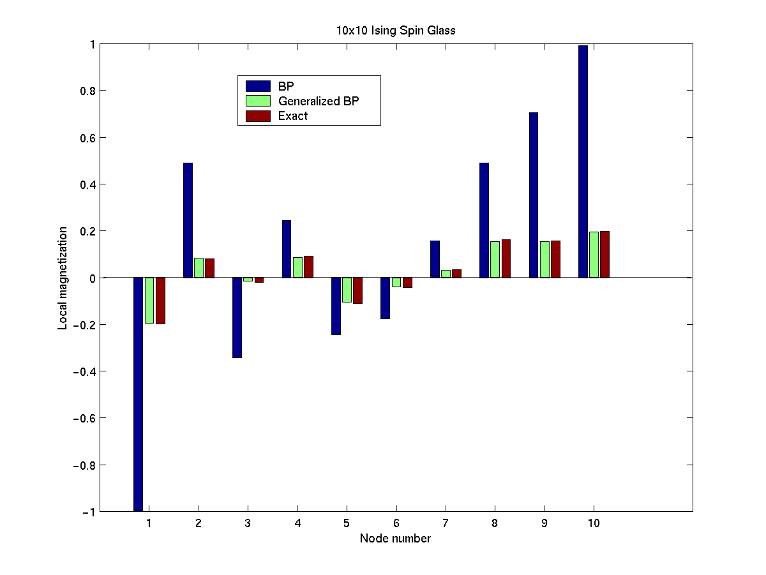

Slide 27
Past / Current / Future Work
Use GBP to develop new decoding methods for error-correcting codes.

